Slide 1
Using Rosetta tablet
For teachers and students

Slide 2
Session goals
Explore Rosetta Tablet as a student.
Understand the current capabilities of the program.
Create a new lesson with a group.

Slide 3
Refer to the handout
Using RosettaTablet.pdf

Slide 4
Rosetta Tablet Capabilities:
Picture practice with text
Pronunciation practice

Slide 5
Refer to the handout
Making a Lesson.PDF

Slide 6
Making a Lesson
Things to consider:
You need at least 4 pictures to make a lesson.
You don’t want ambiguous right answers.
Don’t have father and uncle in the same lesson – students wouldn’t know which adult male to click.
There are certain rules about how you can name files – you cannot use “!,?’:” in filenames.

Slide 7
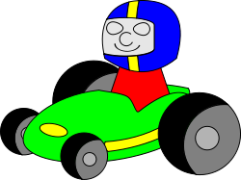
“Translating” Punctuation
tim.leverentz@isd623.org

Slide 8
Where to find pictures
Wikipedia.org – great photos, diagrams
Openclipart.org - cartoons
Images.google.com - everything

Slide 9


Please get into groups – share 1 computer
1 person is the driver
2 other people think of content

Slide 10
“Translating” Punctuation
No space
tim.leverentz@isd623.org

Slide 11
Ideas?
Questions?

